Slide 1
Chapter 19: Network and Distributed Systems

Slide 2
Outline
Advantages of Distributed Systems
Network Structure
Communication Structure
Network and Distributed Operating Systems
Design Issues of Distributed Systems
Distributed File Systems

Slide 3
Objectives
Explain the advantages of networked and distributed systems
Provide a high-level overview of the networks that interconnect distributed systems
Define the roles and types of distributed systems in use today
Discuss issues concerning the design of distributed file systems

Slide 4
Overview
A distributed system is a collection of loosely coupled nodes interconnected by a communications network
Nodes variously called processors, computers, machines, hosts
Site is location of the machine,
Node refers to specific system
Client-server model
A server has several resource it controls.
A client node at a different site wants to use that resources that the server controls.

Slide 5
Overview (Cont.)
Nodes may exist in a client-server, peer-to-peer, or hybrid configuration.
In client-server configuration, server has a resource that a client would like to use
In peer-to-peer configuration, each node shares equal responsibilities and can act as both clients and servers
Communication over a network occurs through message passing
All higher-level functions of a standalone system can be expanded to encompass a distributed system

Slide 6
Distributed System Structure

Slide 7
Reasons for Distributed Systems
Resource sharing
Sharing files or printing at remote sites
Processing information in a distributed database
Using remote specialized hardware devices such as graphics processing units (GPUs)
Computation speedup
Distribute sub-computations among various sites to run concurrently
Load balancing – moving jobs to more lightly-loaded sites
Reliability
Detect and recover from site failure, function transfer, reintegrate failed site

Slide 8
Network Structure
Local-Area Network (LAN) – designed to cover small geographical area
Wide-Area Network (WAN) – links geographically separated sites over a wide area.
Internet of Things (IoT) – a network of Internet connected objects able to collect and exchange data

Slide 9
LAN Structure
Consists of multiple computers (workstations, laptops, mobile devices), peripherals (printers, storage arrays), and routers providing access to other networks
Ethernet and/or Wireless (WiFi) most common way to construct LANs
Ethernet defined by standard IEEE 802.3 with speeds typically varying from 10Mbps to over 10Gbps
WiFi defined by standard IEEE 802.11 with speeds typically varying from 11Mbps to over 400Mbps.
Both standards constantly evolving

Slide 10
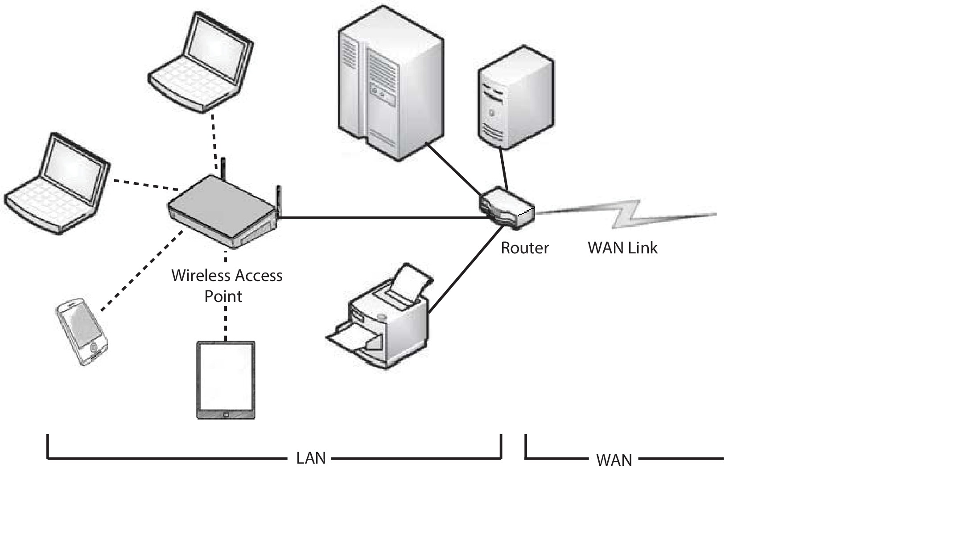
LAN Structure (Cont.)

Slide 11
WAN Structure
Point-to-point connections via links
Telephone lines, leased (dedicated data) lines, optical cable, microwave links, radio waves, and satellite channels
Implemented via routers to direct traffic from one network to another
Internet (World Wide Web) WAN enables hosts worldwide to communicate
Speeds vary
Many backbone providers have speeds at 40-100Gbps
Local Internet Service Providers (ISPs) may be slower
WAN links constantly being upgraded
WANs and LANs interconnect, similar to cell phone network:
Cell phones use radio waves to cell towers
Towers connect to other towers and hubs

Slide 12
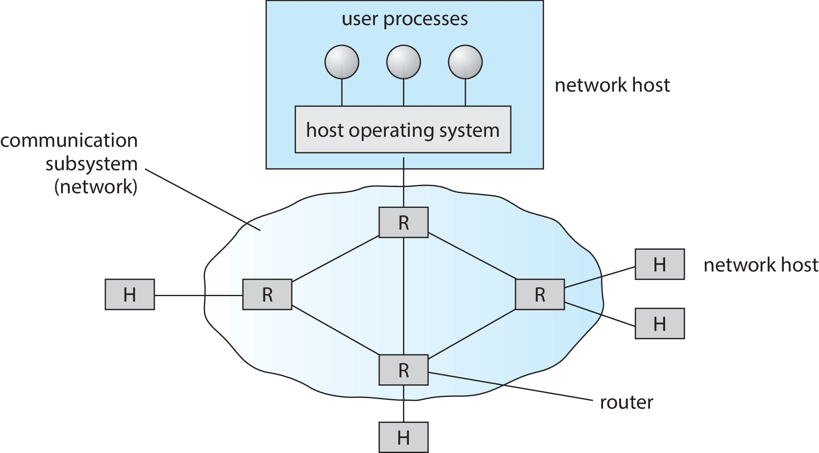
WAN Structure (Cont.)

Slide 13
Naming and Name Resolution
Each computer system in the network has a unique name (computer-id)
Each process in each system has a unique name (process-id)
Identify processes on remote systems by
<host-name, identifier> pair
Domain name system (DNS) – specifies the naming structure of the hosts, as well as name to address resolution (Internet)

Slide 14
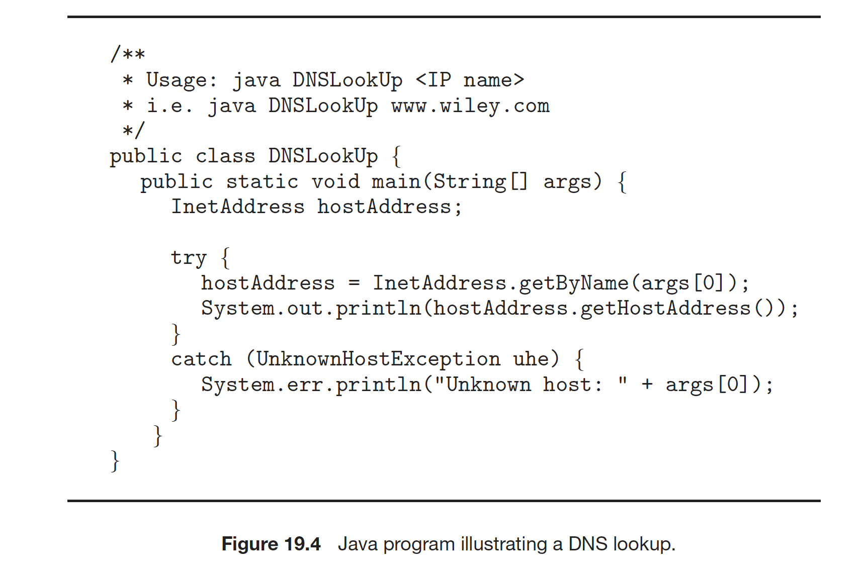
Java Program Illustrating a DNS Lookup

Slide 15
Communication Network
The communication network provides the mechanism of moving data from one node to another node.
The data is shipped via fixed length packets.
The communication network is partitioned into the following seven layers
Layer 1: Physical layer – handles the mechanical and electrical details of the physical transmission of a bit stream
Layer 2: Data-link layer – handles the frames, or fixed-length parts of packets, including any error detection and recovery that occurred in the physical layer

Slide 16
Communication Networks (Cont.)
Layer 3: Network layer – provides connections and routes packets in the communication network, including handling the address of outgoing packets, decoding the address of incoming packets, and maintaining routing information for proper response to changing load levels
Layer 4: Transport layer – responsible for low-level network access and for message transfer between clients, including partitioning messages into packets, maintaining packet order, controlling flow, and generating physical addresses
Layer 5: Session layer – implements sessions, or process-to-process communications protocols
Layer 6: Presentation layer – resolves the differences in formats among the various sites in the network, including character conversions, and half duplex/full duplex (echoing)
Layer 7: Application layer – interacts directly with the users, deals with file transfer, remote-login protocols and electronic mail, as well as schemas for distributed databases

Slide 17
The OSI Network model
The Open Systems Interconnection (OSI) model formalizes some of the earlier work done in network protocols but was developed in the late 1970s and is currently not in widespread use
The OSI model is a conceptual model that characterizes and standardizes the communication functions of a communication network

Slide 18
The OSI Network Model (Cont.)
Logical communication between two computers, with the three lowest-level layers implemented in hardware

Slide 19
OSI Protocol Stack

Slide 20
OSI Network Message

Slide 21
The OSI model and TCP/IP
The most widely adopted protocol stack is the TCP/IP model, which has been adopted by virtually all Internet sites
The TCP/IP protocol stack has fewer layers than the OSI model. Theoretically, because it combines several functions in each layer, it is more difficult to implement but more efficient than OSI networking
The relationship between the OSI and TCP/IP models is shown in the next slide

Slide 22
The OSI and TCP/IP Protocol Stacks

Slide 23
TCP/IP Example
Every host has a name and an associated IP address (host-id)
Hierarchical and segmented
The sending system checks routing tables and locates a router to send packet
The router uses segmented network part of host-id to determine where to transfer packet
This may repeat among multiple routers
Destination system receives the packet
Packet may be complete message, or it may need to be reassembled into larger message spanning multiple packets

Slide 24
TCP/IP Example (Cont.)
Within a network, how does a packet move from sender (host or router) to receiver?
Every Ethernet/WiFi device has a medium access control (MAC) address
Two devices on same LAN communicate via MAC address
If a system needs to send data to another system, it needs to discover the IP to MAC address mapping
Uses address resolution protocol (ARP)
A broadcast uses a special network address to signal that all hosts should receive and process the packet
Not forwarded by routers to different networks

Slide 25
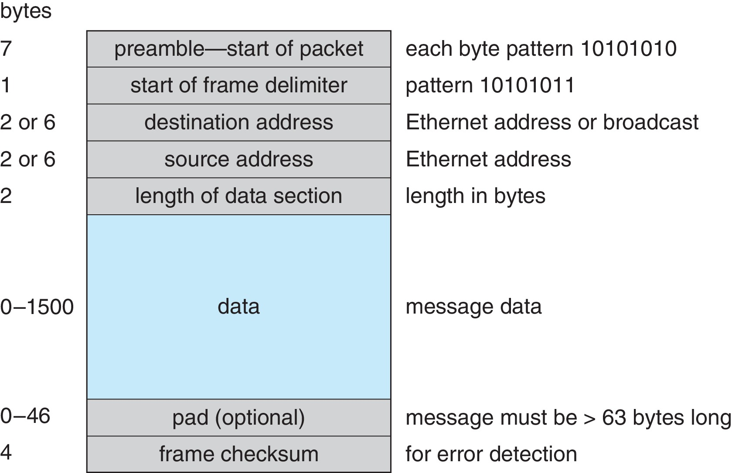
Ethernet Packet

Slide 26
Transport Protocols UDP and TCP
Once a host with a specific IP address receives a packet, it must somehow pass it to the correct waiting process
Transport protocols --TCP and UDP, identify receiving and sending processes through the use of a port number
Allows host with single IP address to have multiple server/client processes sending/receiving packets
Well-known port numbers are used for many services
FTP – port 21
ssh – port 22
SMTP – port 25
HTTP – port 80
Transport protocol can be simple or can add reliability to network packet stream

Slide 27
User Datagram Protocol
UDP is unreliable – bare-bones extension to IP with addition of port number
Since there are no guarantees of delivery in the lower network (IP) layer, packets may become lost
Packets may also be received out-out-order
UDP is also connectionless – no connection setup at the beginning of the transmission to set up state
Also, no connection tear-down at the end of transmission
UDP packets are also called datagrams

Slide 28
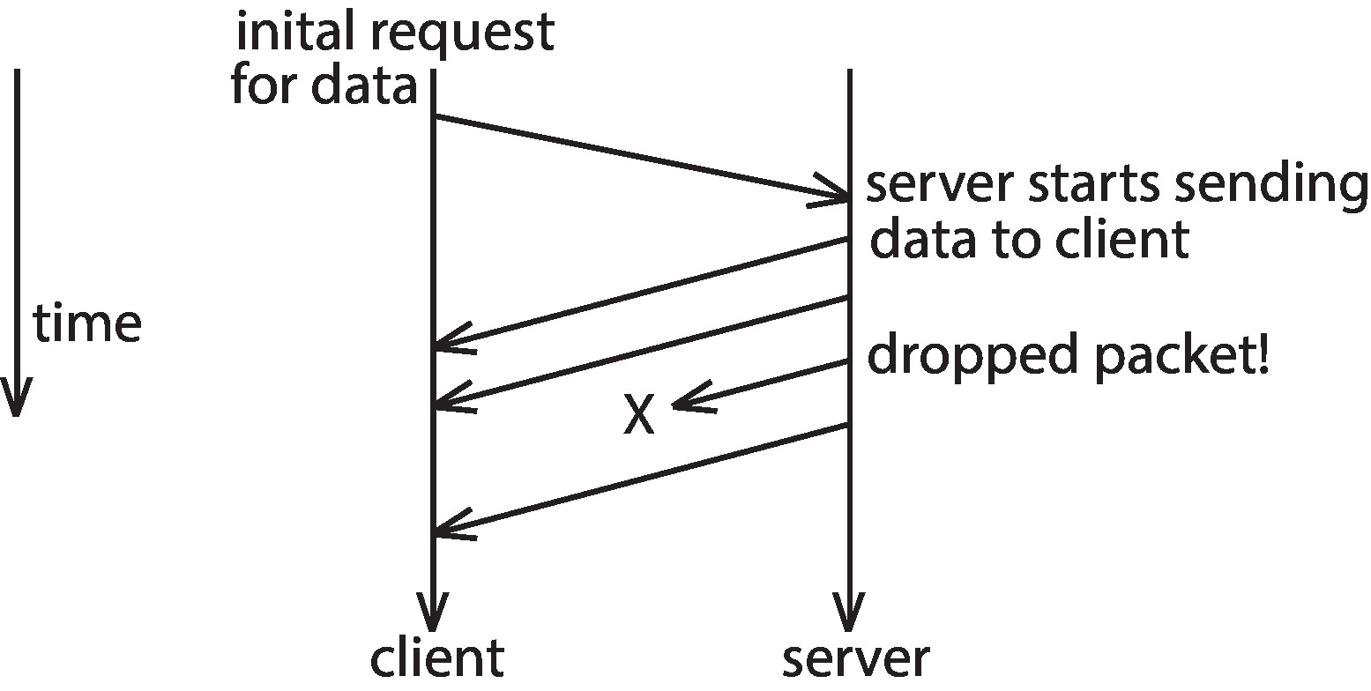
UDP Dropped Packet Example

Slide 29
Transmission Control Protocol
TCP is both reliable and connection-oriented
In addition to port number, TCP provides abstraction to allow in-order, uninterrupted byte-stream across an unreliable network
Whenever host sends packet, the receiver must send an acknowledgement packet (ACK). If ACK not received before a timer expires, sender will resend.
Sequence numbers in TCP header allow receiver to put packets in order and notice missing packets
Connections are initiated with series of control packets called a three-way handshake
Connections also closed with series of control packets

Slide 30
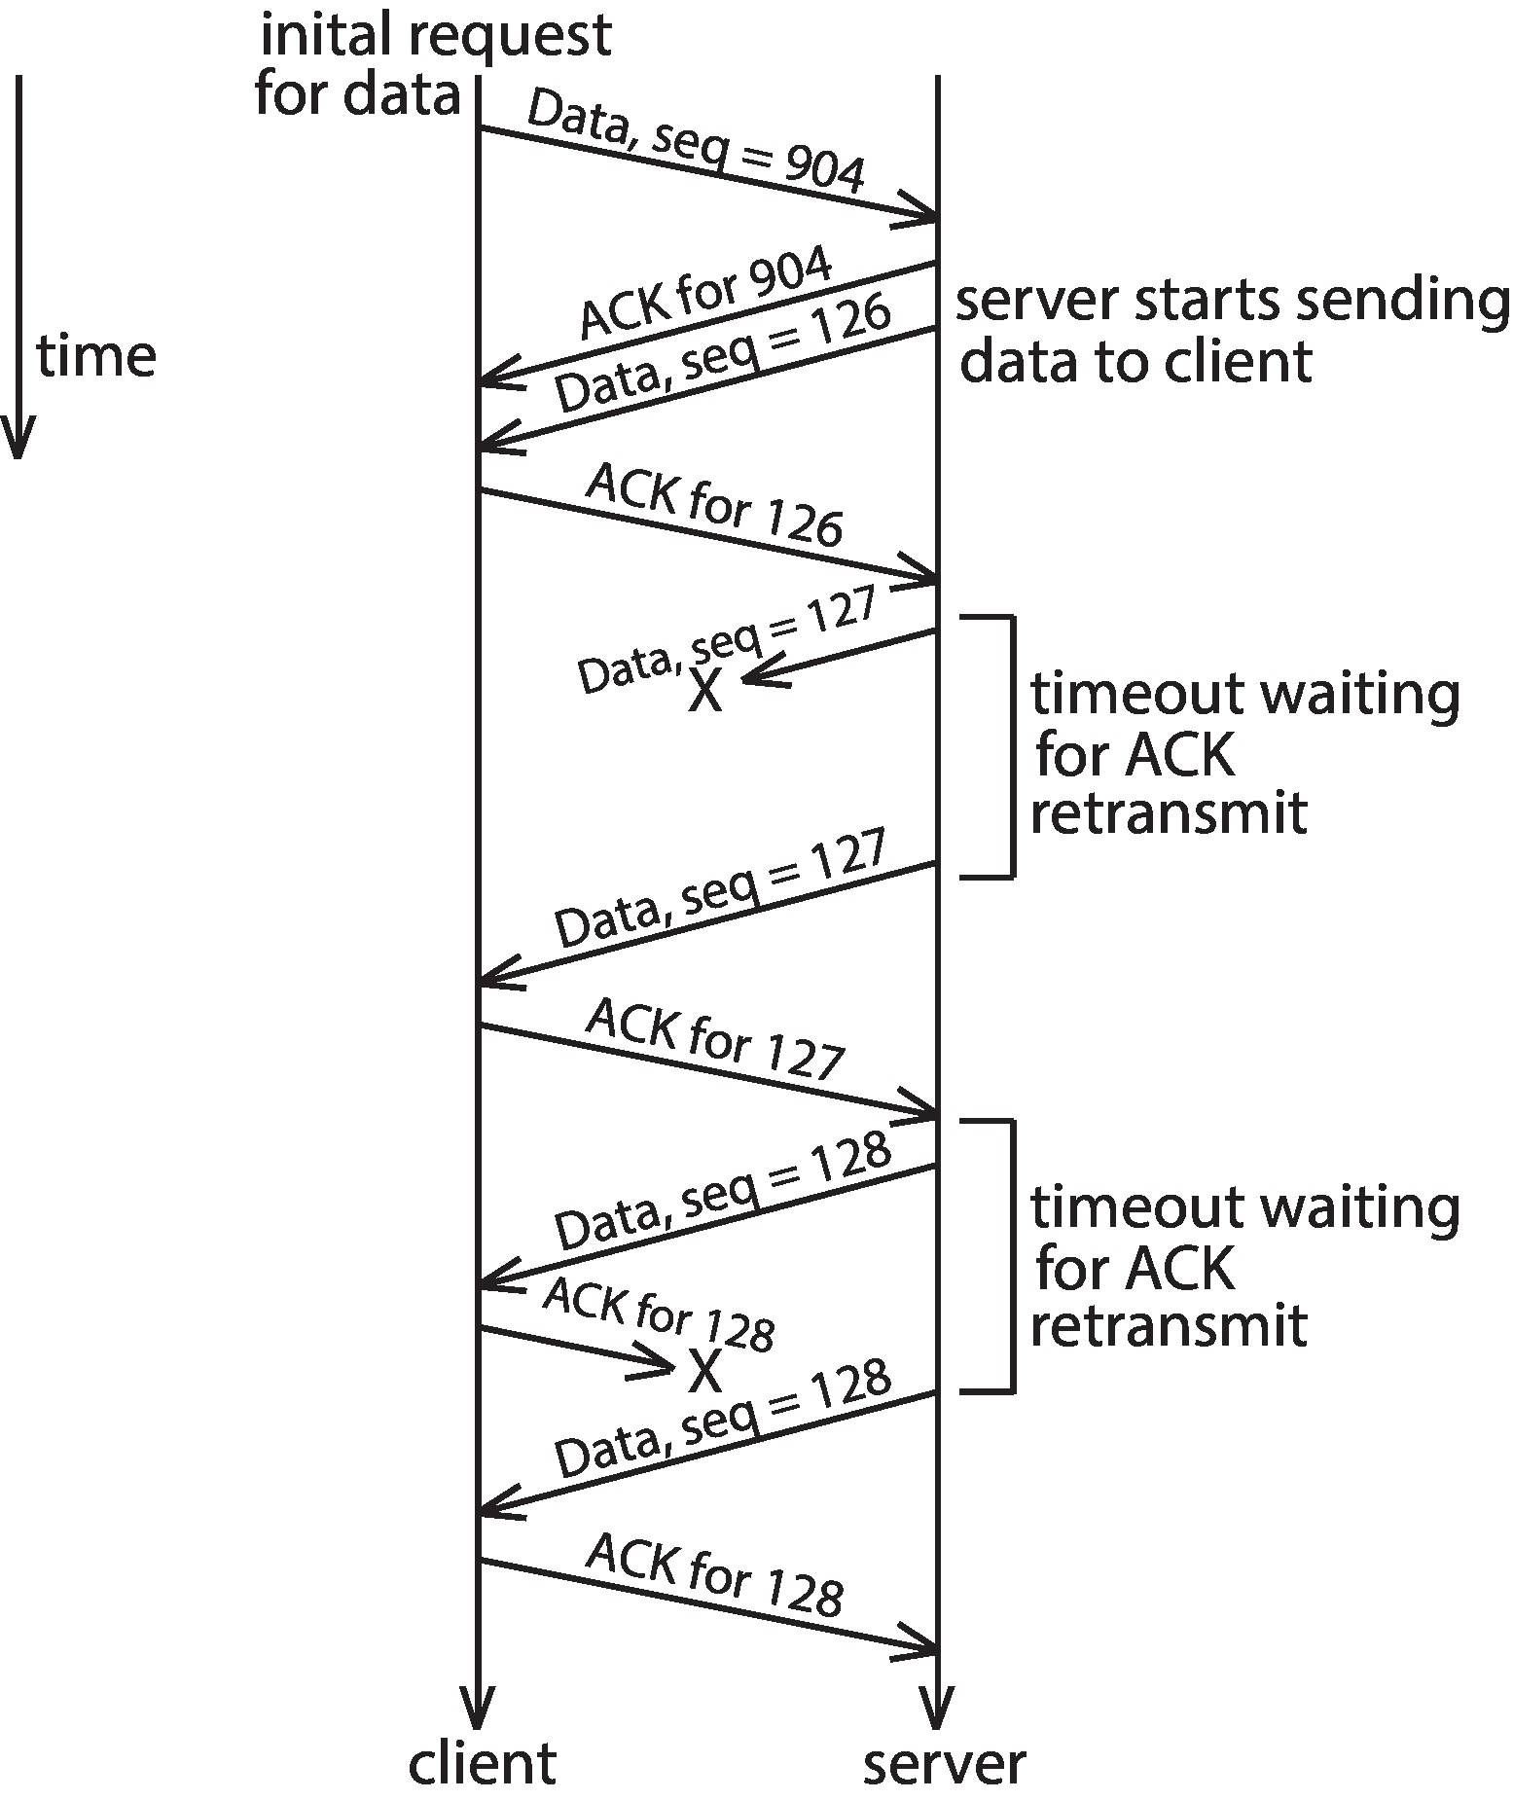
TCP Data Transfer Scenario

Slide 31
Transmission Control Protocol (Cont.)
Receiver can send a cumulative ACK to acknowledge series of packets
Server can also send multiple packets before waiting for ACKs
Takes advantage of network throughput
Flow of packets regulated through flow control and congestion control
Flow control – prevents sender from overrunning capacity of receiver
Congestion control – approximates congestion of the network to slow down or speed up packet sending rate

Slide 32
Network-oriented Operating Systems
Two main types
Network Operating Systems
Users are aware of multiplicity of machines
Distributed Operating Systems
Users not aware of multiplicity of machines

Slide 33
Network Operating Systems
Users are aware of multiplicity of machines
Access to resources of various machines is done explicitly by:
Remote logging into the appropriate remote machine (ssh)
ssh kristen.cs.yale.edu
Transferring data from remote machines to local machines, via the File Transfer Protocol (FTP) mechanism
Upload, download, access, or share files through cloud storage
Users must change paradigms – establish a session, give network-based commands, use a web browser
More difficult for users

Slide 34
Distributed Operating Systems
Users not aware of multiplicity of machines
Access to remote resources similar to access to local resources
Two modes of migration:
Data Migration – transfer data by transferring entire file, or transferring only those portions of the file necessary for the immediate task
Computation Migration – transfer the computation, rather than the data, across the system
Via remote procedure calls (RPCs)
Via messaging system

Slide 35
Process Migration
Process Migration – execute an entire process, or parts of it, at different sites.
Reason for process migration
Load balancing – distribute processes across network to even the workload
Computation speedup – subprocesses can run concurrently on different sites
Hardware preference – process execution may require specialized processor
Software preference – required software may be available at only a particular site
Data access – run process remotely, rather than transfer all data locally
Consider the World Wide Web

Slide 36
Design Issues of Distributed Systems
Three design questions:
Robustness – Can the distributed system withstand failures?
Transparency – Can the distributed system be transparent to the user both in terms of where files are stored and user mobility?
Scalability – Can the distributed system be scalable to allow addition of more computation power, storage, or users?

Slide 37
Robustness
Hardware failures can include:
Failure of a link,
Failure of a site, and
Loss of a message.
A fault-tolerant system can tolerate a certain level of failure
Degree of fault tolerance depends on design of system and the specific fault
The more fault tolerance, the better!
Involves:
Failure detection,
Reconfiguration, and
Recovery

Slide 38
Failure Detection
Detecting hardware failure is difficult
To detect a link failure, a heartbeat protocol can be used
Assume Site A and Site B have established a link
At fixed intervals, each site will exchange an I-am-up message indicating that they are up and running
If Site A does not receive a message within the fixed interval, it assumes either
The other site is not up, or
The message was lost
Site A can now send an Are-you-up? message to Site B
If Site A does not receive a reply, it can repeat the message or try an alternate route to Site B

Slide 39
Failure Detection (Cont.)
If Site A does not ultimately receive a reply from Site B, it concludes some type of failure has occurred
Types of failures:
Site B is down
The direct link between A and B is down
The alternate link from A to B is down
The message has been lost
However, Site A cannot determine exactly why the failure has occurred

Slide 40
Reconfiguration and Recovery
When Site A determines a failure has occurred, it must reconfigure the system:
If the link from A to B has failed, this must be broadcast to every site in the system
If a site has failed, every other site must also be notified indicating that the services offered by the failed site are no longer available
When the link or the site becomes available again, this information must again be broadcast to all other sites

Slide 41
Transparency
A distributed system should appear as a conventional, centralized system to the user
User interface should not distinguish between local and remote resources
Example: NFS
User mobility allows users to log into any machine in the environment and see his/her environment
Example: LDAP plus desktop virtualization

Slide 42
Scalability
As demands increase, the system should easily accept the addition of new resources to accommodate the increased demand
Reacts gracefully to increased load
Adding more resources may generate additional indirect load on other resources if not careful
Data compression can cut down on storage and network resources used

Slide 43
Distributed File System (DFS)
A file system whose clients, servers, and storage devices are dispersed among the machines of a distributed system
Should appear to its clients as a conventional, centralized file system
Key distinguishing feature is management of dispersed storage devices

Slide 44
Distributed File System -- Definitions
Service – software entity running on one or more machines and providing a particular type of function to a priori unknown clients
Server – service software running on a single machine
Client – process that can invoke a service using a set of operations that forms its client interface
A client interface for a file service is formed by a set of primitive file operations (create, delete, read, write)
Client interface of a DFS should be transparent; i.e., not distinguish between local and remote files
Sometimes lower-level inter-machine interface need for cross-machine interaction

Slide 45
Distributed File System -- Models
Two widely-used architectural models include:
Client-server model
Cluster-based model
Challenges include:
Naming and transparency
Remote file access
Caching and cache consistency

Slide 46
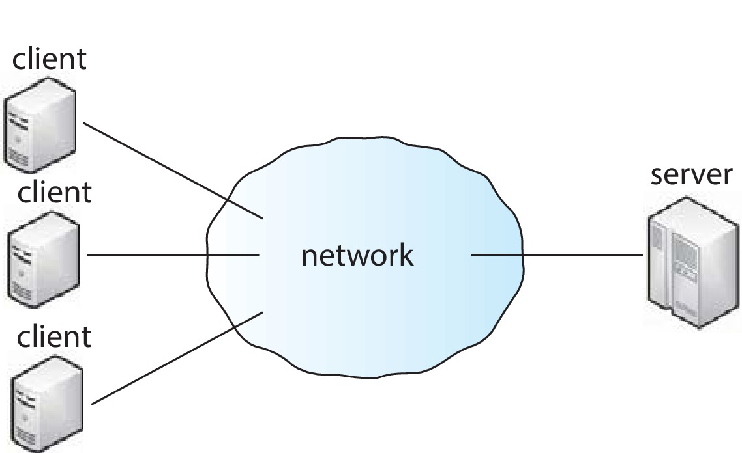
Client-Server Model

Slide 47
Client-Server Model (Cont.)
Servers store both files and metadata on attached storage
Clients contact the server to request files
Sever responsible for authentication, checking file permissions, and delivering the file
The changes that client makes to a file must be propagated back to the server
Popular examples include NFS and OpenAFS
Design suffers from single point of failure if server crashes
Server presents a bottleneck for all requests of data and metadata
Could pose problems with scalability and bandwidth

Slide 48
Cluster-based Model
Built to be more fault-tolerant and scalable than client-server DFS
Examples include the Google File System (GFS) and Hadoop Distributed File System (HDFS)
Clients connected to master metadata server and several data servers that hold “chunks” (portions) of files
Metadata server keeps mapping of which data servers hold chunks of which files
As well as hierarchical mapping of directories and files
File chunks replicated n times

Slide 49
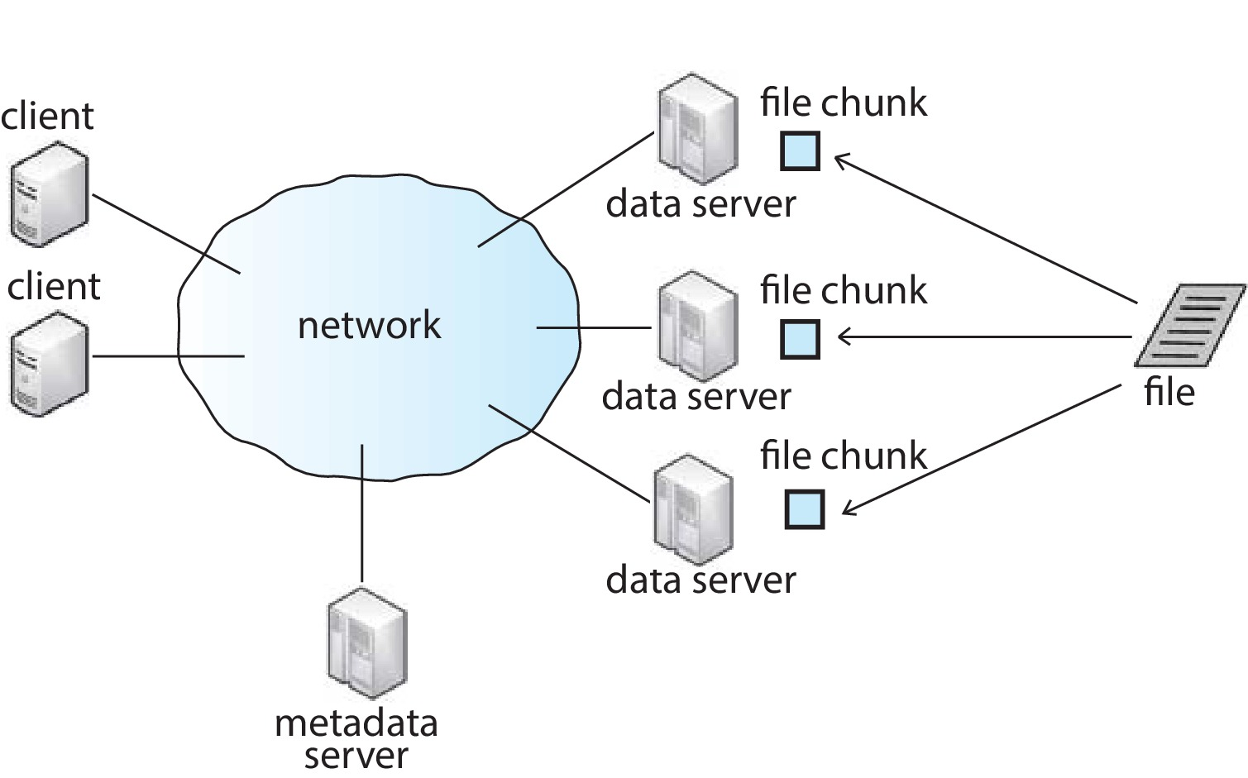
Cluster-based Model (Cont.)

Slide 50
Cluster-based Model (Cont.)
GFS design was influenced by following observations:
Hardware component failures are the norm rather than the exception and should be routinely expected.
Files stored on such a system are very large.
Most files are changed by appending new data to the end rather than overwriting existing data.
Redesigning the applications and file system API increases system flexibility
Requires applications to be programmed specially with new API
Modularized software layer MapReduce can sit on top of GFS to carry out large-scale parallel computations while utilizing benefits of GFS
Hadoop framework also stackable and modularized

Slide 51
Naming and Transparency
Naming – mapping between logical and physical objects
Multilevel mapping – abstraction of a file that hides the details of how and where on the disk the file is actually stored
A transparent DFS hides the location where in the network the file is stored
For a file that is replicated in several sites, the mapping returns a set of the locations of this file’s replicas; both the existence of multiple copies and their location are hidden

Slide 52
Naming Structures
Location transparency – file name does not reveal the file’s physical storage location
Location independence – file name does not need to be changed when the file’s physical storage location changes
In practice, most DFSs use static, location-transparent mapping for user-level names
Some support file migration (e.g., OpenAFS)
Hadoop supports file migration but without following POSIX standards; hides information from clients
Amazon S3 provides blocks of storage on demand via APIs, placing storage dynamically and moving data as necessary

Slide 53
Naming Schemes
Files named by combination of their host name and local name, which guarantees a unique system-wide name.
This naming scheme is neither location transparent nor location independent.
Attach remote directories to local directories, giving the appearance of a coherent directory tree.
Only previously mounted remote directories can be accessed transparently
Single global name structures spans all files in the system. If a server is unavailable, some arbitrary set of directories on different machines also becomes unavailable

Slide 54
Remote File Access
Consider a user who requests access to a remote file. The server storing the file has been located by the naming scheme, and now the actual data transfer must take place.
Remote-service mechanism is one transfer approach.
A requests for accesses are delivered to the server, the server machine performs the accesses, and their results are forwarded back to the user.
One of the most common ways of implementing remote service is the RPC paradigm

Slide 55
Remote File Access (Cont.)
Reduce network traffic by retaining recently accessed disk blocks in a cache, so that repeated accesses to the same information can be handled locally
If needed data not already cached, a copy of data is brought from the server to the user
Accesses are performed on the cached copy
Files identified with one master copy residing at the server machine, but copies of (parts of) the file are scattered in different caches
Cache Location
Disk vs. Main Memory
Cache-consistency problem – keeping the cached copies consistent with the master file
Could be called network virtual memory

Slide 56
Cache Location – Disk vs. Main Memory
Advantages of disk caches
More reliable
Cached data kept on disk are still there during recovery and don’t need to be fetched again
Advantages of main-memory caches:
Permit workstations to be diskless
Data can be accessed more quickly
Performance speedup in bigger memories
Server caches (used to speed up disk I/O) are in main memory regardless of where user caches are located; using main-memory caches on the user machine permits a single caching mechanism for servers and users

Slide 57
Cache Update Policy
Write-through – write data through to disk as soon as they are placed on any cache
Reliable, but poor performance
Delayed-write (write-back) – modifications are written to the cache and then written through to the server later
Write accesses complete quickly; some data may be overwritten before they are written back, and so need never be written at all
Poor reliability; unwritten data will be lost whenever a user machine crashes
Variation – scan cache at regular intervals and flush blocks that have been modified since the last scan
Variation – write-on-close, writes data back to the server when the file is closed
Best for files that are open for long periods and frequently modified

Slide 58
Consistency
Is locally cached copy of the data consistent with the master copy?
Client-initiated approach
Client initiates a validity check
Server checks whether the local data are consistent with the master copy
Server-initiated approach
Server records, for each client, the (parts of) files it caches
When server detects a potential inconsistency, it must react

Slide 59
Consistency (Cont.)
In cluster-based DFS, cache-consistency issue is more complicated due to presence of metadata server and replicated file data chunks
Hadoop Distributed File System (HDFS) allows append-only write operations (no random writes) and a single file writer
Google File System (GFS) allows random writes with concurrent writers
Complicates write consistency guarantees for GFS while simplifying it for HDFS

Slide 60
End of Chapter 19

Slide 61
Communication Network
The communication network is partitioned into the following seven layers:
Layer 1: Physical layer – handles the mechanical and electrical details of the physical transmission of a bit stream
Layer 2: Data-link layer – handles the frames, or fixed-length parts of packets, including any error detection and recovery that occurred in the physical layer
Layer 3: Network layer – provides connections and routes packets in the communication network, including handling the address of outgoing packets, decoding the address of incoming packets, and maintaining routing information for proper response to changing load levels

